Slide 1
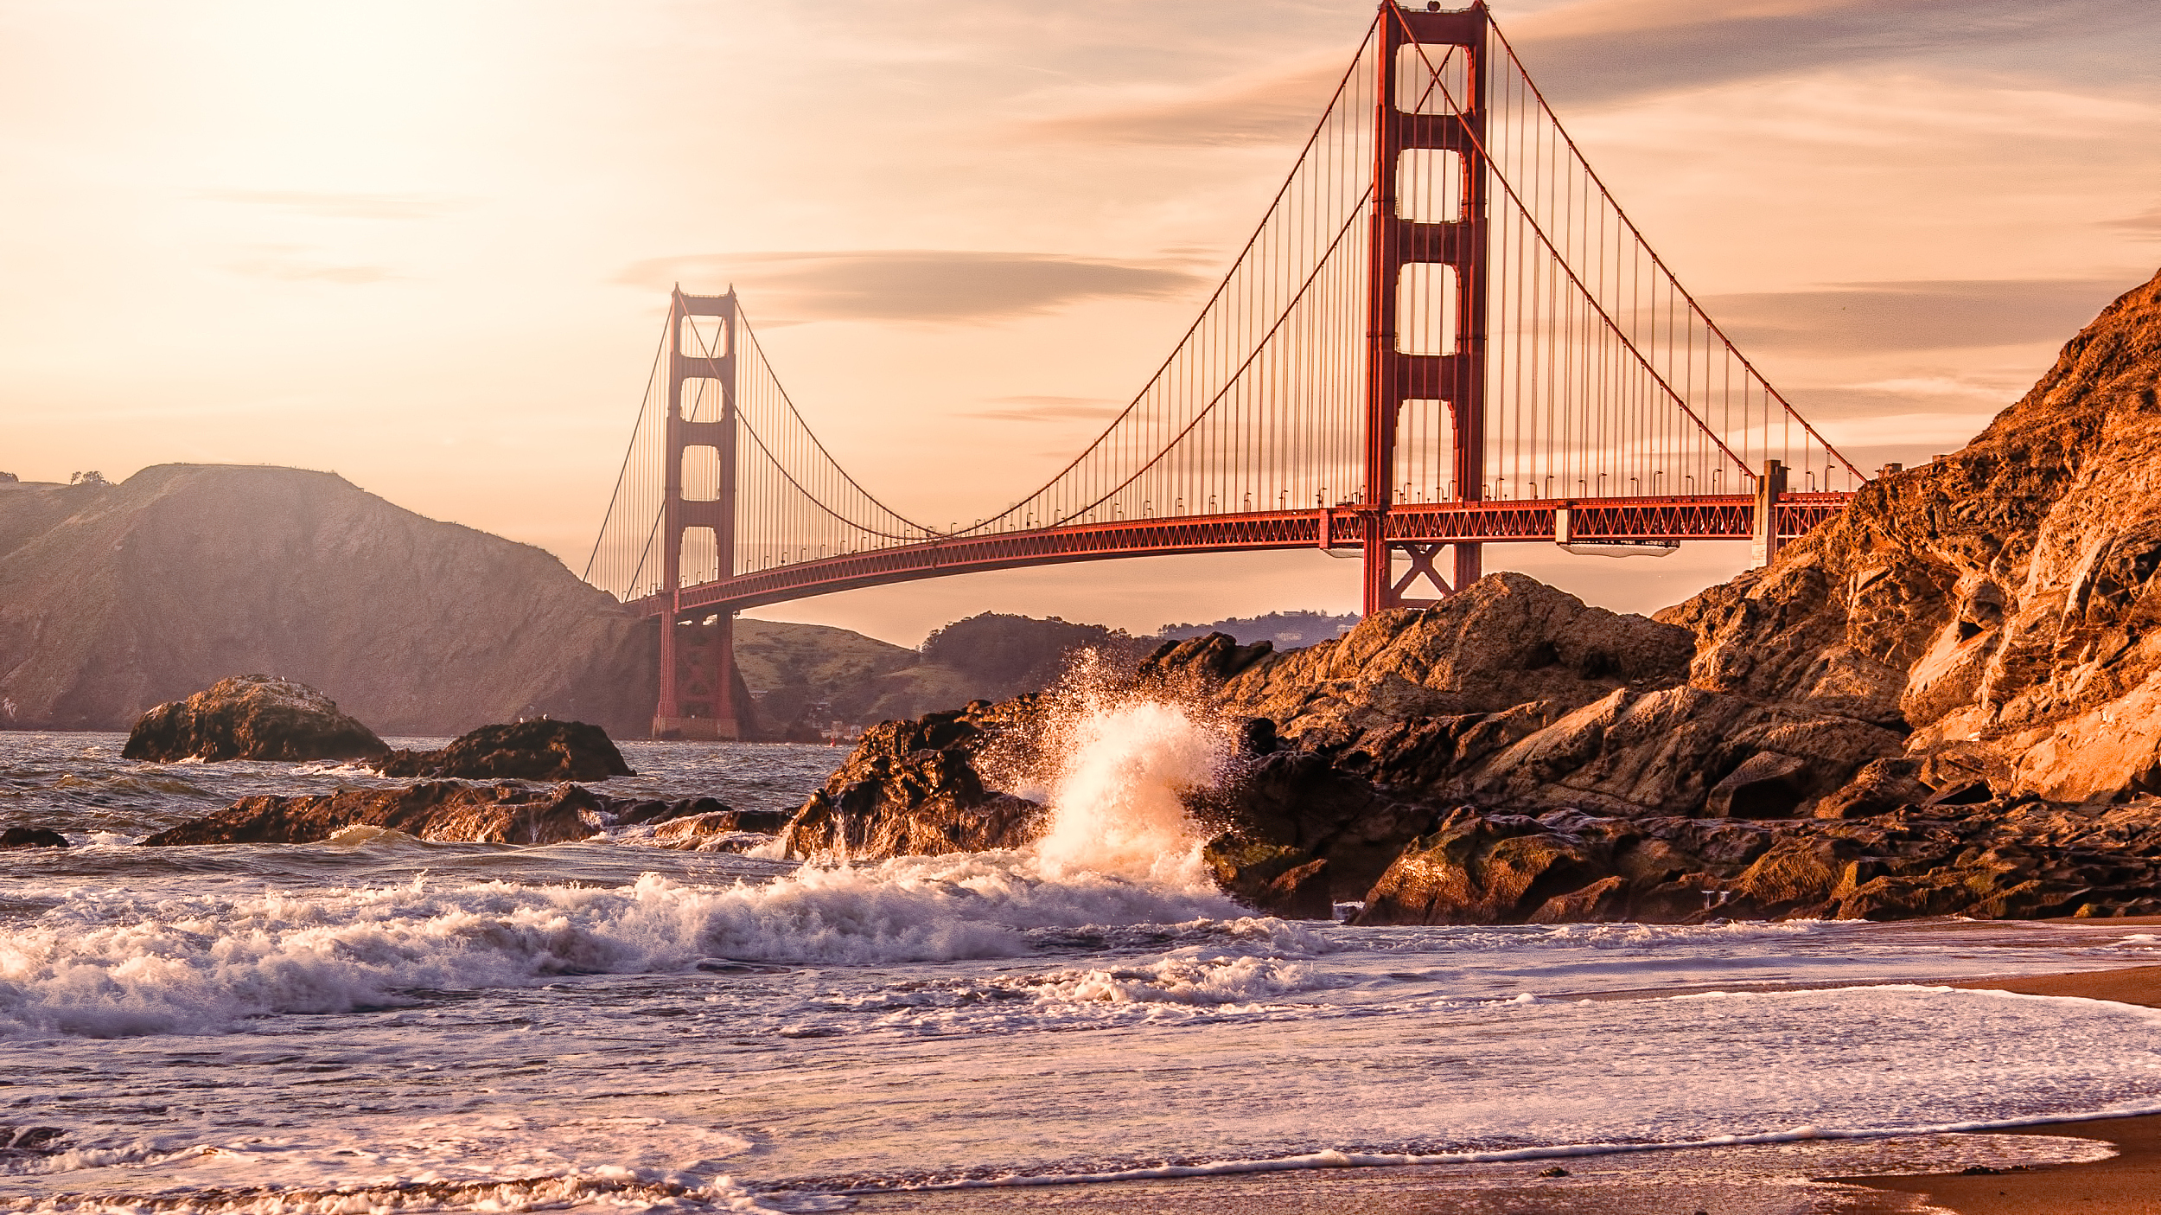
San Francisco Bay Area

Slide 2
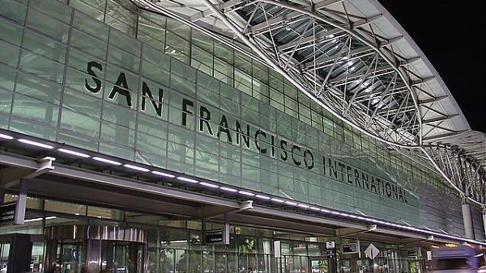
San Francisco International Airport
The 23rd largest airport in the world
Organized and Fast

Slide 3

Getting into Town

Slide 4
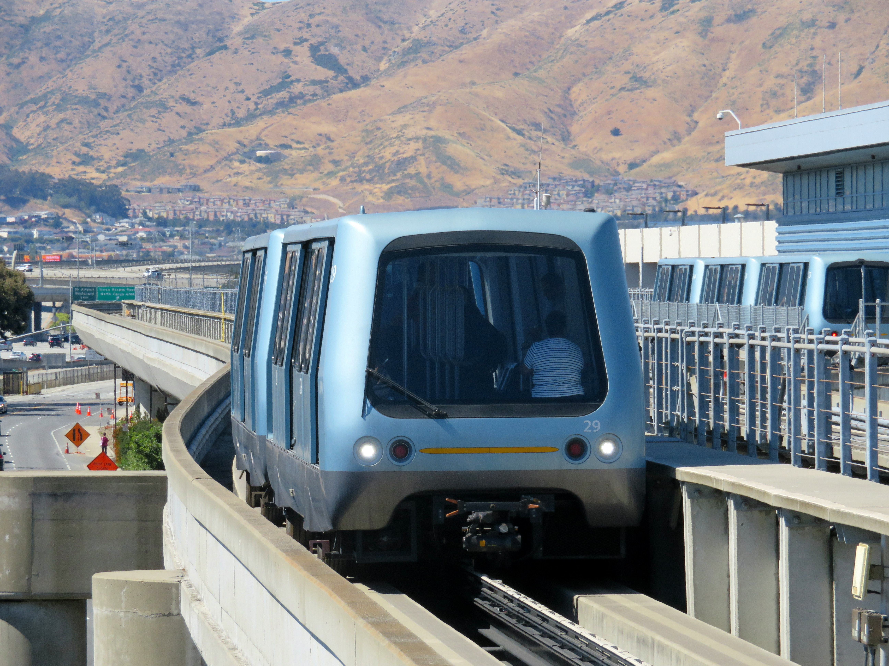
AirTrain

Slide 5
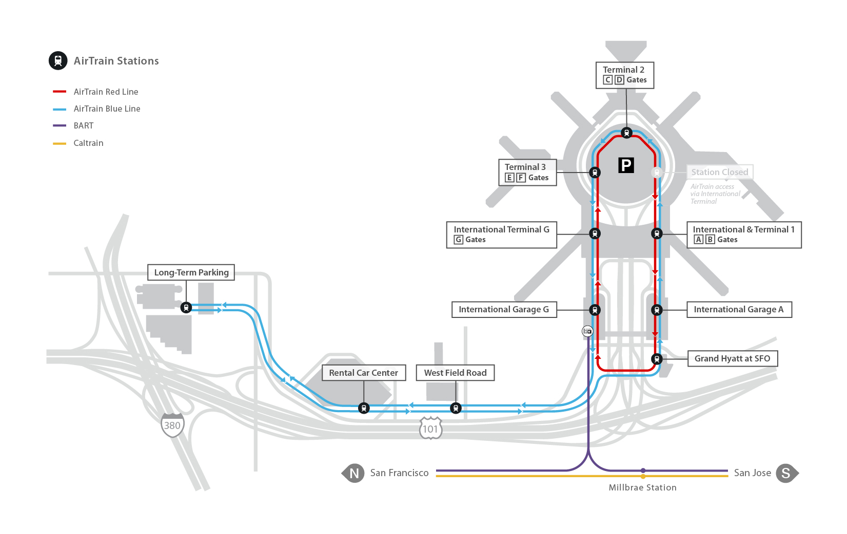
AirTrain System Map

Slide 6
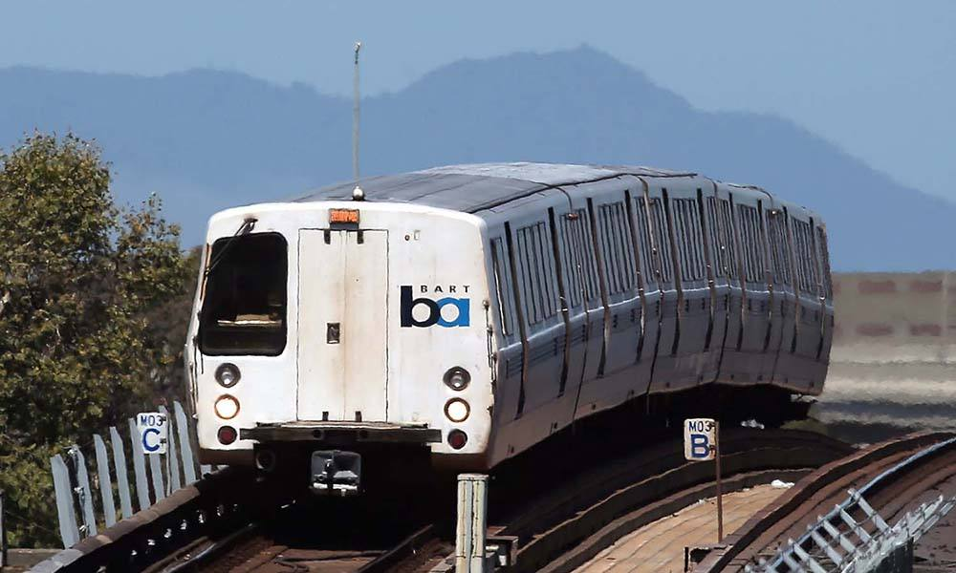
The BART (Bay Area Rapid Transit)

Slide 7
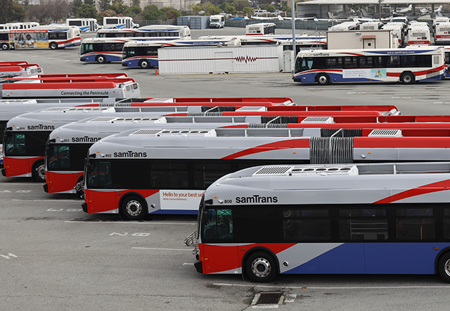
SamTrans

Slide 8
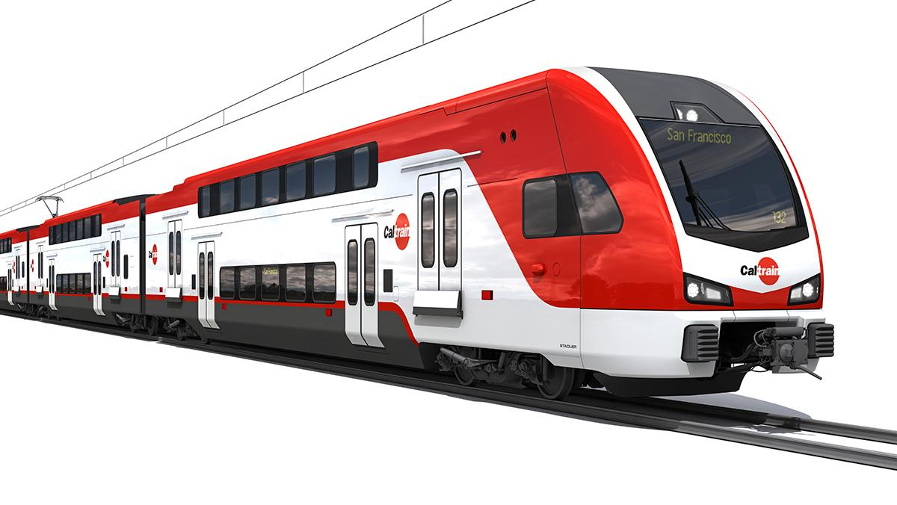
Caltrain

Slide 9
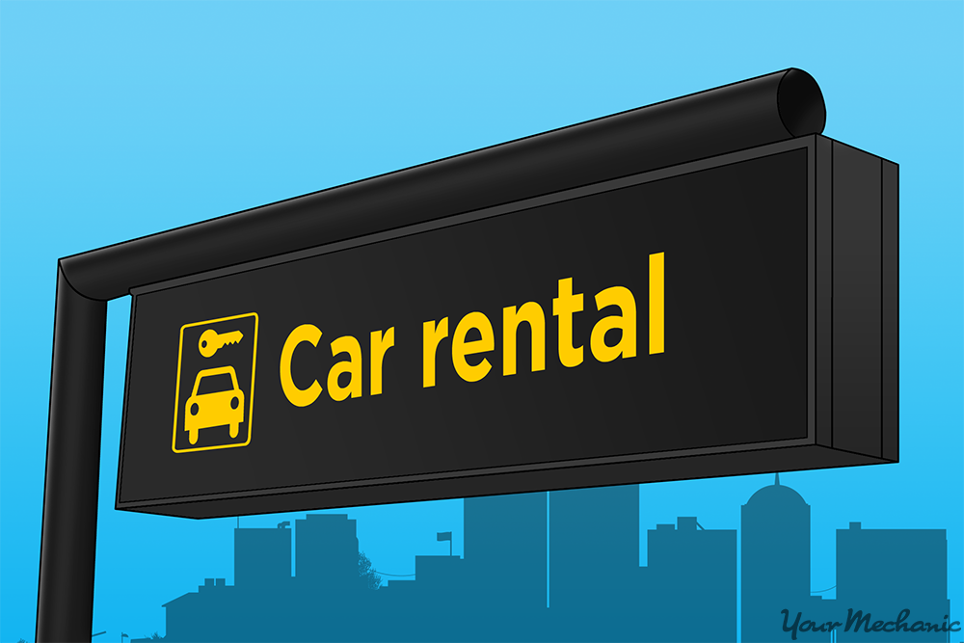
Rent a Car

Slide 10

Ride a Bike

Slide 11
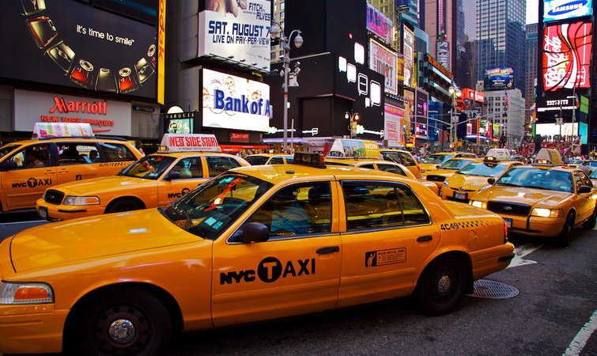
Take a Taxi

Slide 12

Taxis

Slide 13
Pricing
Starting Price:
US$3.5
(for the first 322 meters)
Then:
US$1.71
/ kilometer

Slide 14

Rapid Transit

Slide 15

Fast, Save, Reliable, Clean and Quality

Slide 16
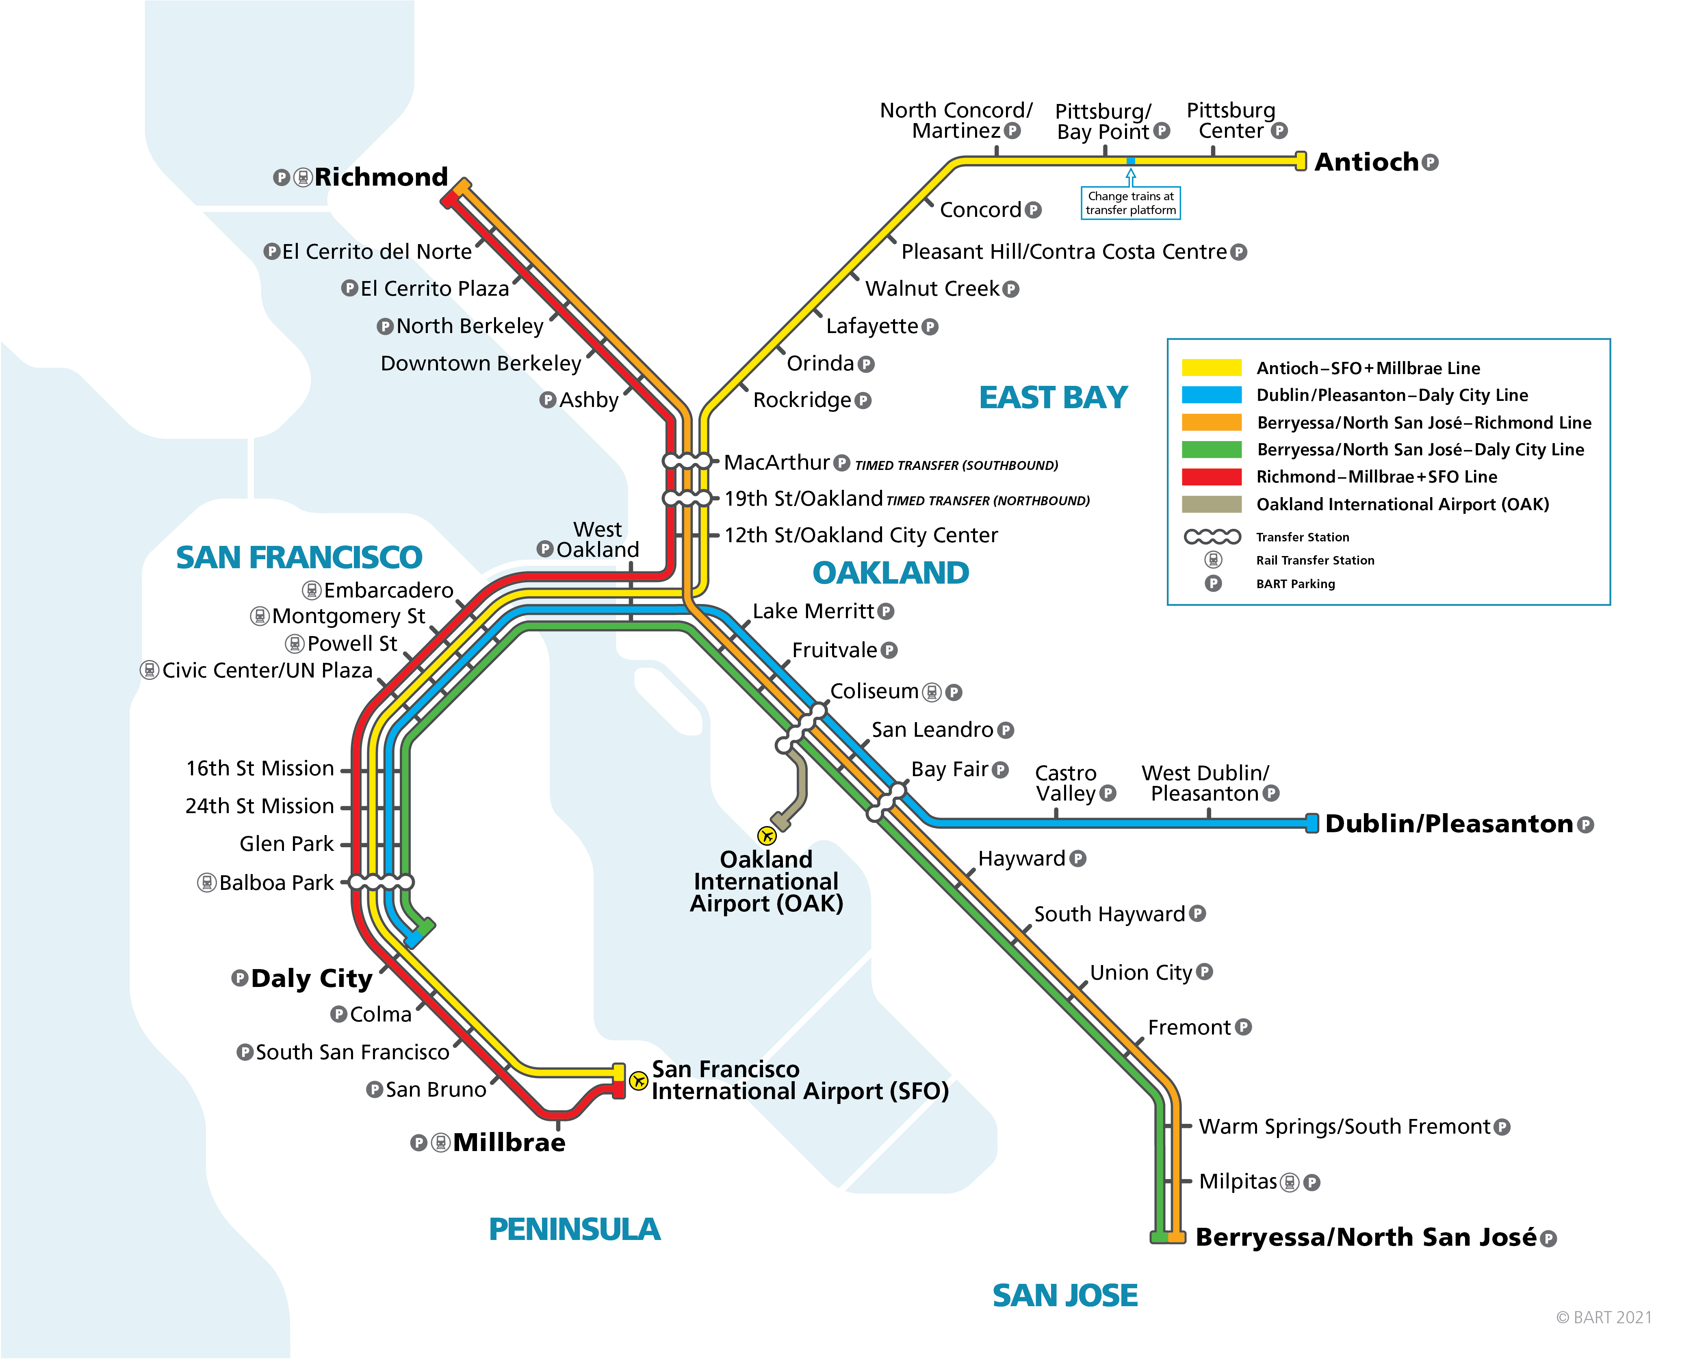
BART System Map

Slide 17

Weather

Slide 18
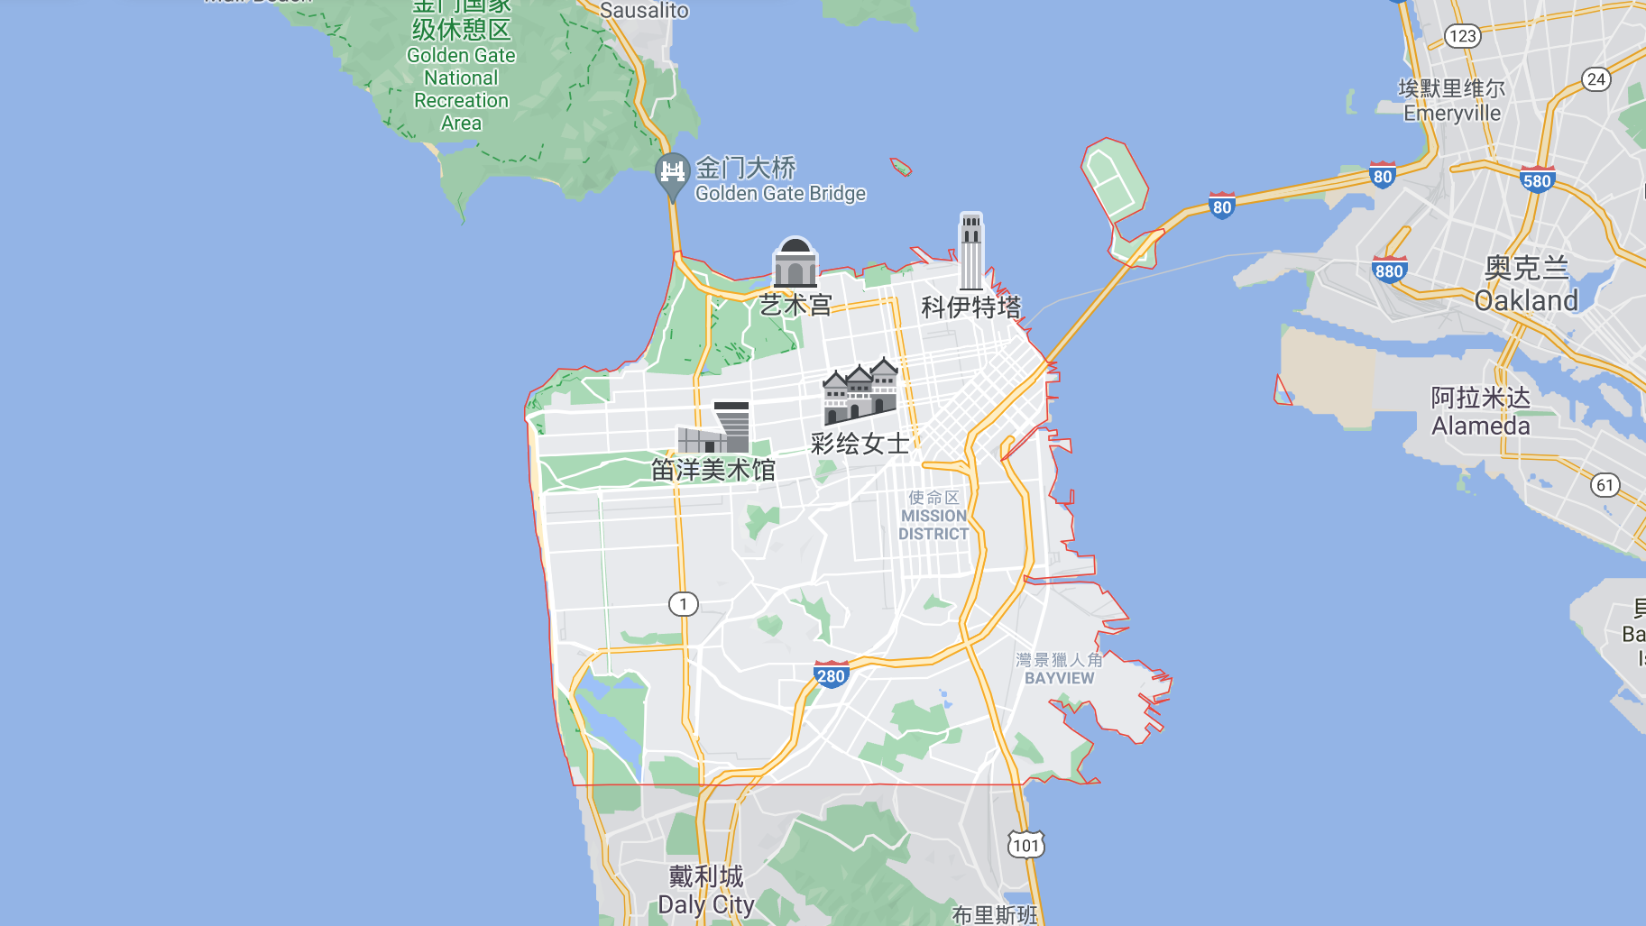
旧金山

Slide 19
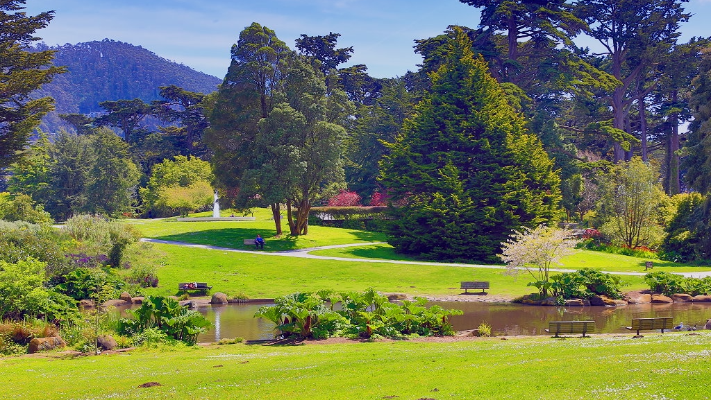
Summer

Slide 20
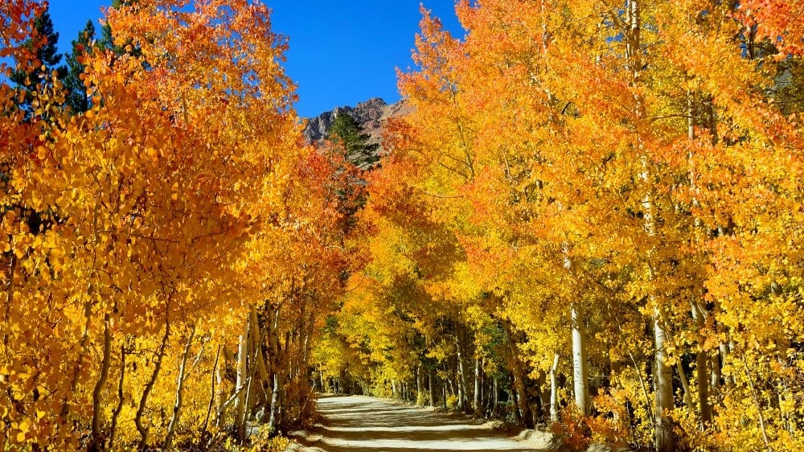
Autumn

Slide 21

Dining

Slide 22


Californian Restaurant

Slide 23

Tipping

Slide 24
Tipping in a restaurant
Choose Your Plan
Poor Service
10%
Generally
15%
Good Service
20%

Slide 25
In other aspects, a
15%
tip is generally given.

Slide 26

A Ride and a Walk

Slide 27
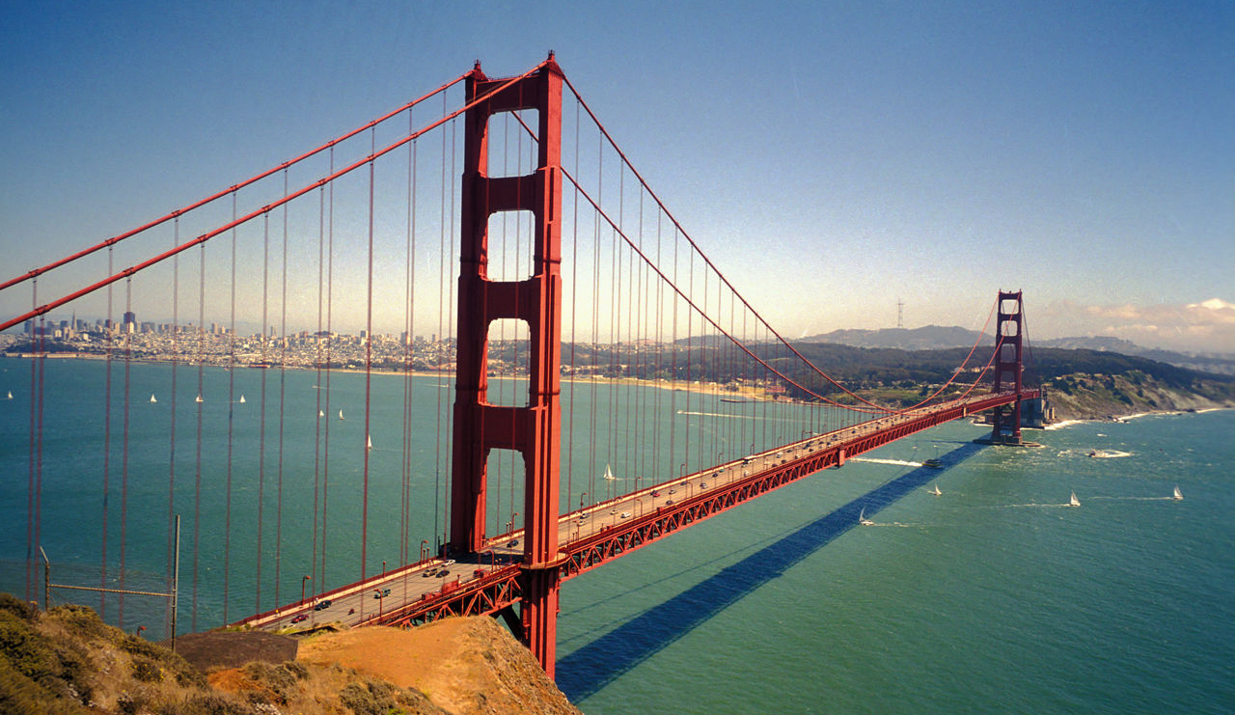

Slide 28
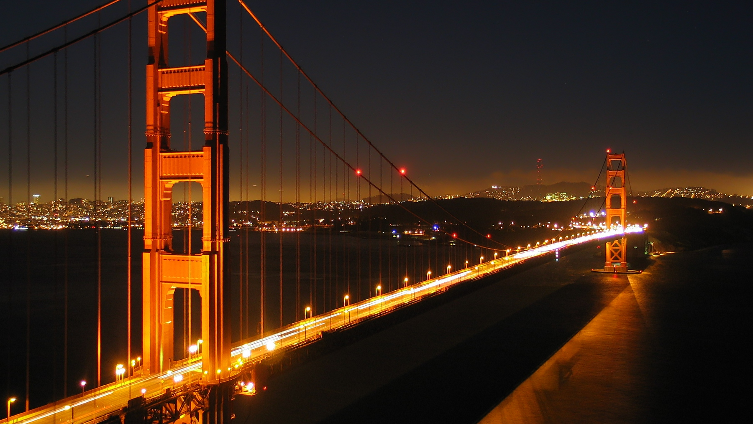

Slide 29
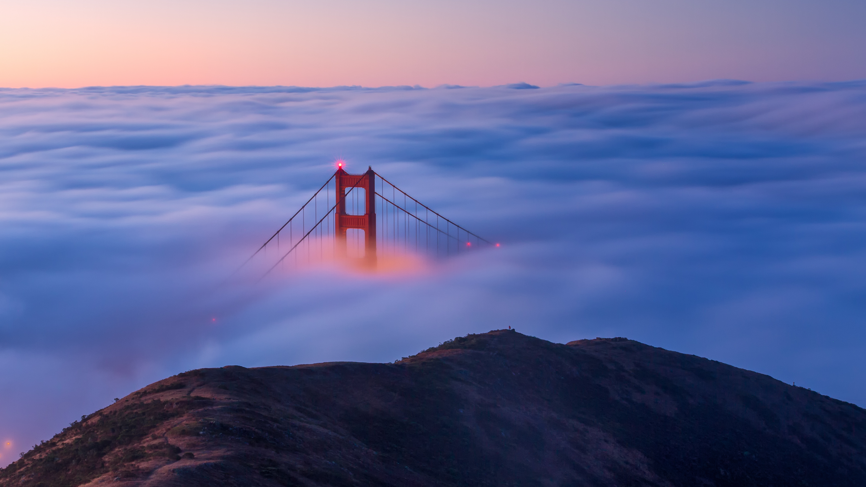

Slide 30
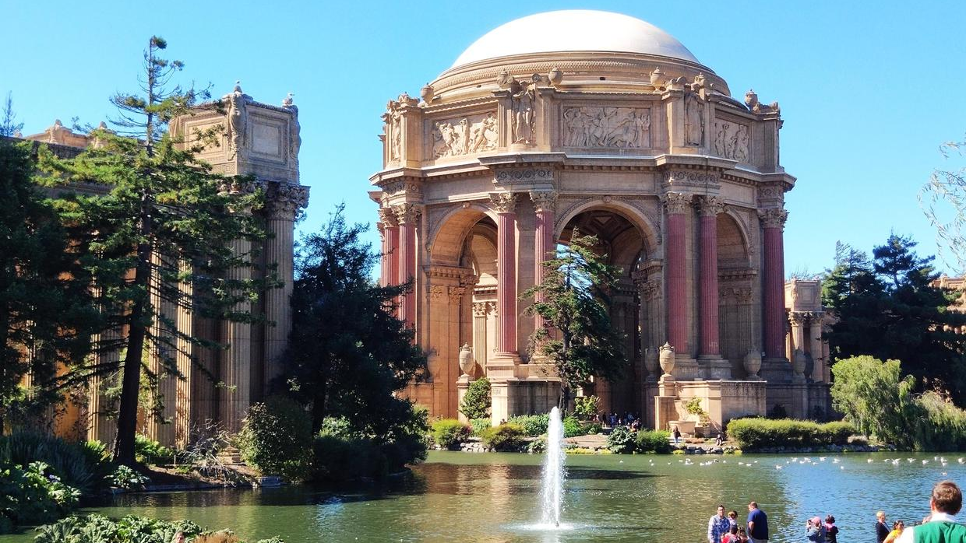

Slide 31
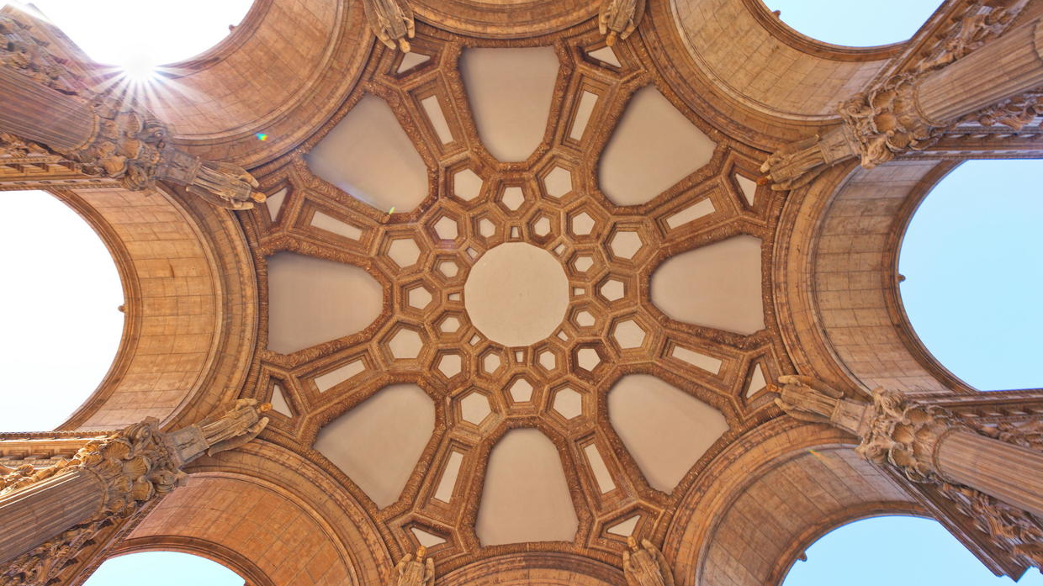

Slide 32
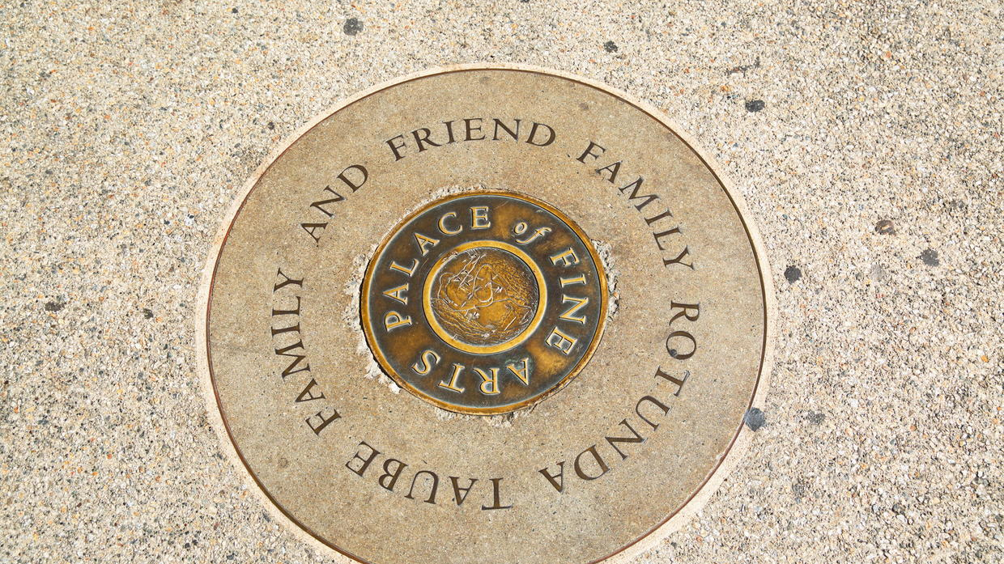

Slide 33

Technology

Slide 34
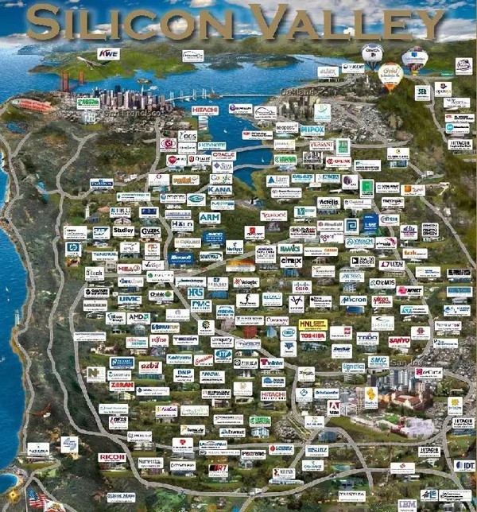

Slide 35
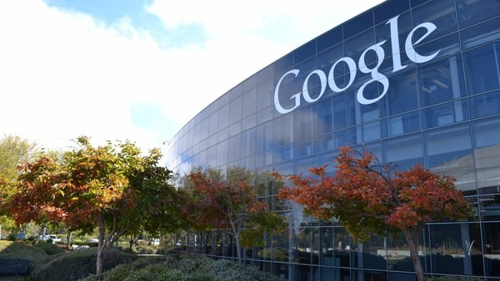

Slide 36
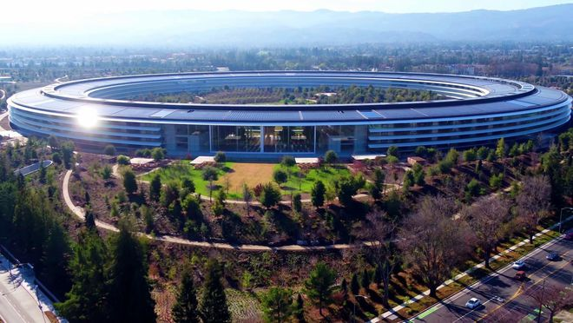

Slide 37
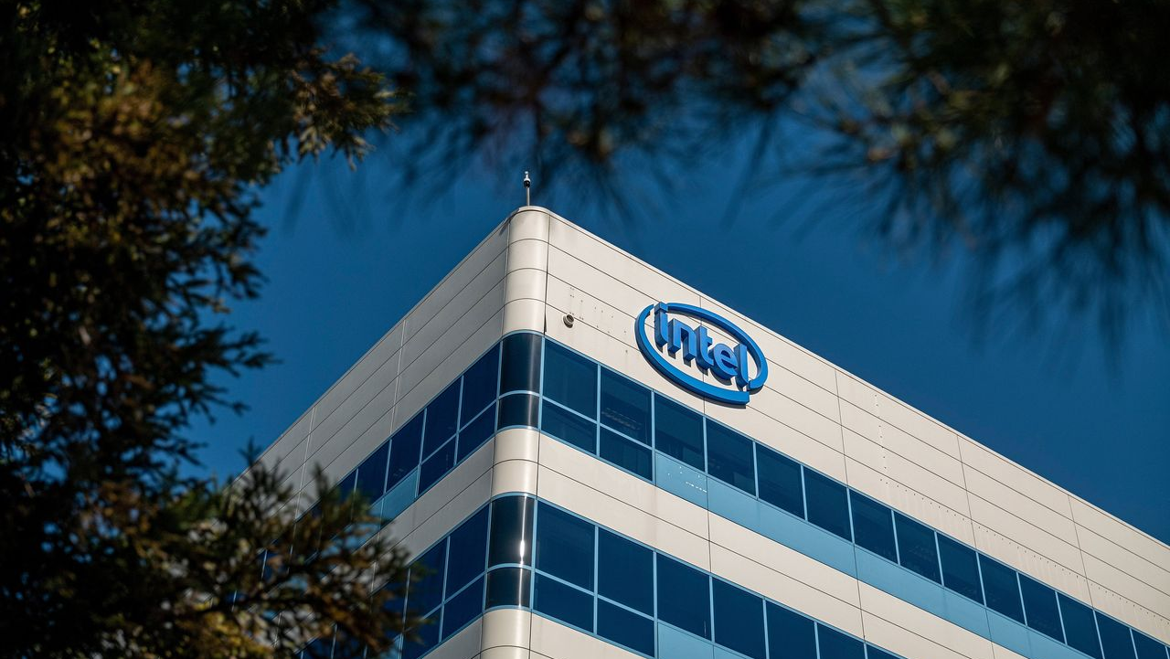

Slide 38
The End
Copyright © 2021 CYY. All rights reserved.

Slide 39
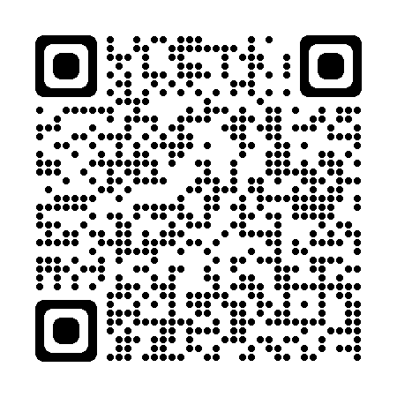
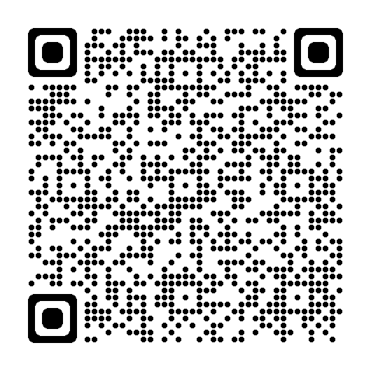
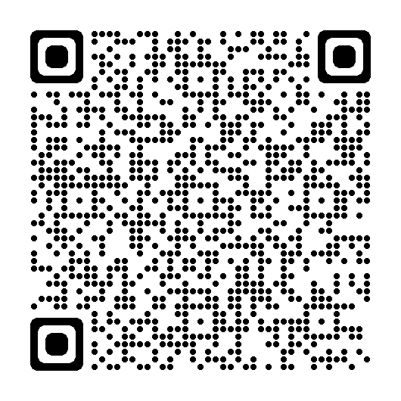
This file is open source. In other words, you can download it by scanning the QR Code below.
Speech (PDF)
Speech (DOCX)
PowerPoint (PPTX)
Copyright © 2021 CYY. All rights reserved.

